Slide 1
An Introduction to Regularized Regression
Machine Learning and Causal Inference
Susan Athey
Thanks to Sendhil Mullainathan for sharing slides; see Mullainathan and Speiss (2017) JEP which covers much of this material

Slide 2
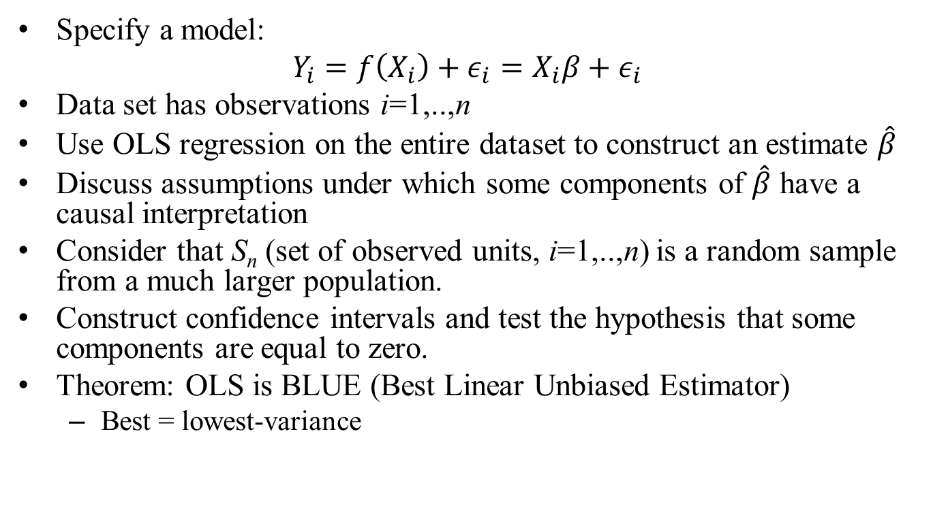
What we do in Econometrics: The Case of Regression
Specify a model:
$$Y_{i}=f\left(X_{i}\right)+ε_{i}=X_{i}β+ε_{i}$$
Data set has observations i=1,..,n
Use OLS regression on the entire dataset to construct an estimate $\hat{β}$
Discuss assumptions under which some components of $\hat{β}$ have a causal interpretation
Consider that S_{n} (set of observed units, i=1,..,n) is a random sample from a much larger population.
Construct confidence intervals and test the hypothesis that some components are equal to zero.
Theorem: OLS is BLUE (Best Linear Unbiased Estimator)
Best = lowest-variance

Slide 3
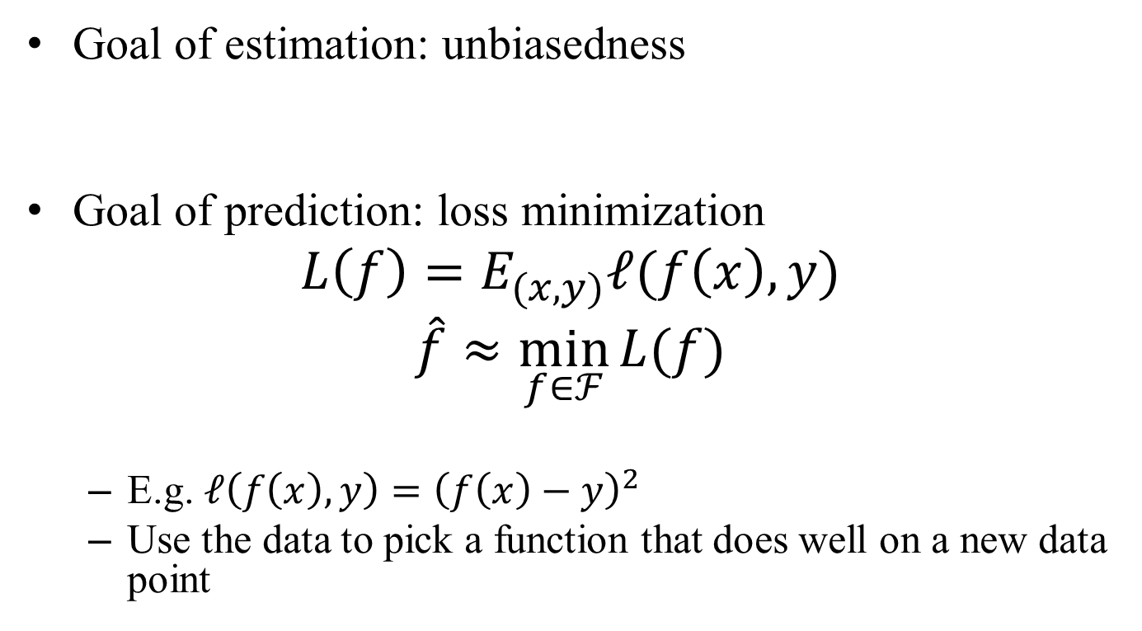
Goals of Prediction and Estimation
Goal of estimation: unbiasedness
Goal of prediction: loss minimization
$$L\left(f\right)=E_{(x,y)}ℓ(f\left(x\right),y)$$
$$\hat{f}≈\min_{f∈ℱ}{L(f)}$$
E.g. $ℓ\left(f\left(x\right),y\right)={\left(f\left(x\right)−y\right)}^{2}$
Use the data to pick a function that does well on a new data point

Slide 4
Key assumptions in both cases
Stationary data generating process
Estimation:
Interested in a parameter of that process
Prediction:
Interested in predicting y

Slide 5
High v. Low Dimensional Analysis
We have discussed prediction as a high dimensional construct
Practically that is where it is useful
But to understand how high dimensional prediction works we must unpack an implicit presumption
Presumption: Our known estimation strategies would be great predictors if they were feasible

Slide 6




A Simple OLS example
Suppose we truly live in a linear world
Write x = (1,x)

Slide 7
OLS seems like a good predictor
Especially since it is known to be efficient

Slide 8
An Even Simpler Set-up
Let’s get even lower dimensional
No variables at all
Suppose you get the data of the type:
You would like to estimate the mean

Slide 9

Forming an estimator of the mean
Minimize bias: $α=1$
The sample mean is an unbiased estimator
Also what you would get from OLS regression on a constant

Slide 10
A prediction problem
In the same setup, you are given n data points
You would like to guess the value of a new data point from the same distribution
Goal: minimize quadratic loss of prediction

Slide 11

Best Predictor
$$ℓ(\hat{μ},y)]$$

Slide 12
The higher alpha the lower the bias
The higher alpha the more variable across samples it is

Slide 13
Key problem
The unbiased estimator has a nice property:
But getting that property means large sample to sample variation of estimator
This sample to sample variation means that in any particular finite sample I’m paying the cost of being off on all my predictions

Slide 14
Intuition
I see your first test score. What should my prediction of your next test be?
Your first test score is an unbiased estimator
But it is very variable
Note: “Bayesian” intuition
Even simpler: what was my guess before I saw any information
Shrink to that
In this example I’m shrinking to zero

Slide 15
But in a way you know this
As empiricists you already have this intuition

Slide 16
Back to Simple OLS example
Suppose we truly live in a linear world
Write x = (1,x)

Slide 17
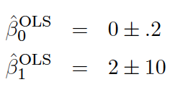
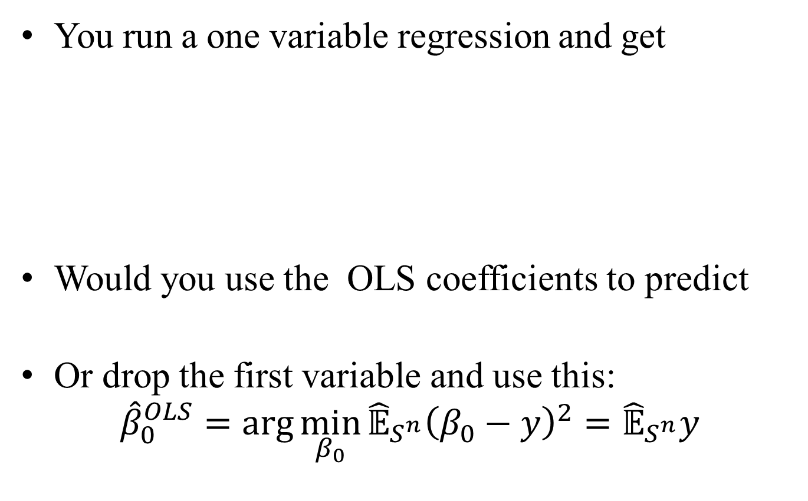
A Simple Example
You run a one variable regression and get
Would you use the OLS coefficients to predict
Or drop the first variable and use this:
$${\hat{β}}_{0}^{OLS}=\arg{\min_{β_{0}}{{\hat{𝔼}}_{S^{n}}{\left(β_{0}−y\right)}^{2}}={\hat{𝔼}}_{S^{n}}y}$$

Slide 18
Deciding whether to drop
Suppose in the (impossible) case we got the true world right.
(0,2) are the right coefficients
Of course OLS does perfectly (by assumption).
But how would OLS do on new samples…where (0,2) being the generating coefficients?
We’re giving OLS a huge leg up here.

Slide 19
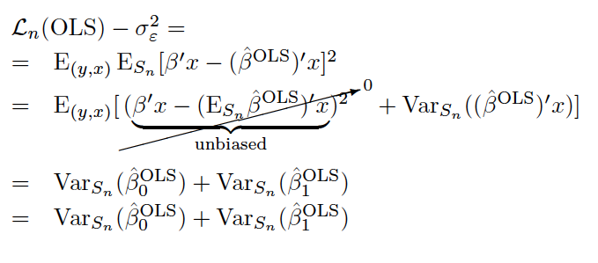
OLS Performance

Slide 20
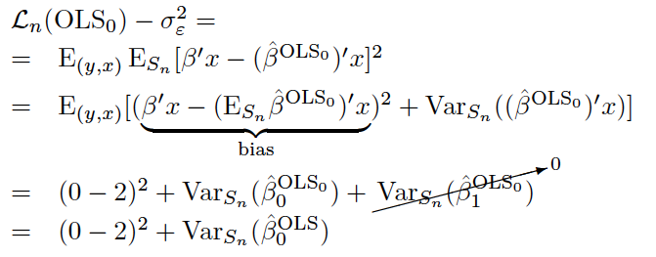
What if we dropped the variable

Slide 21
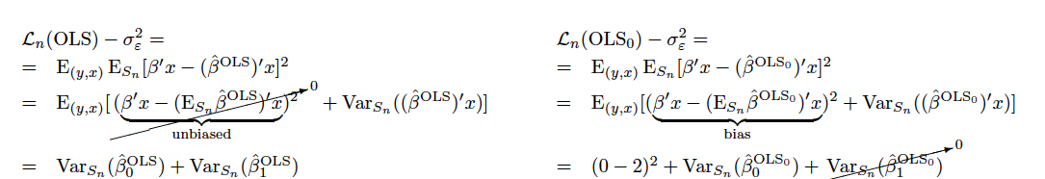

Your standard error worry!

Slide 22
Where does your standard error intuition come from?
You see a standard error
You think “that variable is not ‘significant’” so you might not want to include it.
But this is misleading

Slide 27
Your Standard Error Worry
For hypothesis testing se tells you whether the coefficient is significant are not
For prediction it’s telling you how variable an estimator using it really is

Slide 28
Dual purposes of the standard eror
The standard error also tells you that even if you’re right on average:
Your estimator will produce a lot of variance
And then in those cases you make systematic prediction mistakes.
Bias variance tradeoff
Being right on average on the coefficient is not equal to the best predictor.

Slide 29
The Problem Here
Prediction quality suffers from:
Biased coefficients
Variability in estimated coefficients
Even if the true coefficient is 2, in any sample, we will estimate something else
OLS is lexicographic
First ensure unbiased
Amongst unbiased estimators: seek efficiency
Good predictions must trade these off

Slide 30
Two Variable Example
Belaboring the point here…
Assume now that we have two variables
As before, both normally distributed unit variance
Your estimator produces

Slide 31
What would you do now?
Logic above suggests you would drop both variables?
Or keep both variables?
It really depends on how you feel about the variance (10)?

Slide 32
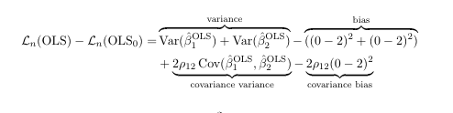
Calculation

Slide 33
Hidden in Bias-Variance Tradeoff
Covariance is central
The standard error on several variables can be large, even though together their effect is highly consistent
For prediction covariance between x matters

Slide 34
In a way this problem is not important
The variance term diminishes with sample size
Prediction-estimation wedge falls off as
But variance term increases with “variables”
Prediction-estimation rises with k
So this is a problem when…
Function class high dimensional relative to data

Slide 35
What this means practically
In some cases what you already know (estimation) is perfectly fine for prediction
This is why ML textbooks teach OLS, etc.
They are perfectly useful for the kinds of prediction problems ML tries to solve in low dimensional settings
But in high dimensional settings…
Note: high dimensional does not ONLY mean lots of variables! It can mean rich interactions.

Slide 36
So far…
All this gives you a flavor of how the prediction task is not mechanically a consequence of the estimation task
But it doesn’t really tell you how to predict
Bias variance tradeoff is entirely unactionable
What’s the bias?
What’s the variance?
This is not really a tradeoff you can make
A different look at the same problem produces a practical insight though

Slide 37
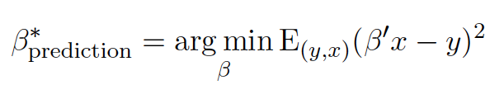

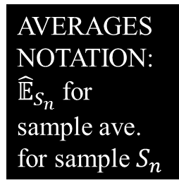
Back to OLS
$${\hat{β}}^{\text{OLS}}=\arg{\min_{β}{{\hat{𝔼}}_{S_{n}}{\left(β^{′}x−y\right)}^{2} }}$$
The real problem here is minimizing the “wrong” thing: In-sample fit vs out-of-sample fit
AVERAGES
NOTATION:
${\hat{𝔼}}_{S_{n}}$ for sample ave. for sample $S_{n}$

Slide 38
Overfit problem
OLS looks good with the sample you have
It’s the best you can do on this sample
Bias-variance improving predictive power is about improving out of sample predictive power
Problem is OLS by construction overfits
We overfit in estimation

Slide 39
This problem is exactly why wide data is troubling
Similarly think of the wide data case
Why are we worried about having so many variables?
We’ll fit very well (perfectly if k > n) in sample
But arbitrarily badly out of sample

Slide 40
Understanding overfit
Let’s consider a general class of algorithms

Slide 41
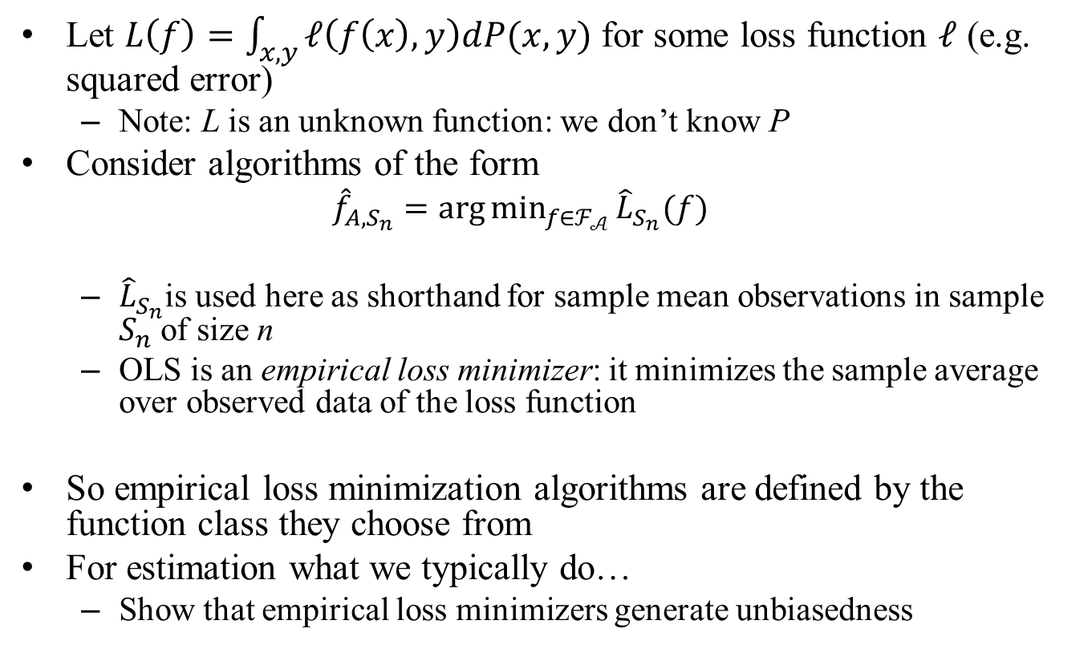
A General Class of Algorithms
Let $L\left(f\right)=\int_{x,y}{ℓ\left(f\left(x\right),y\right)dP(x,y)}$ for some loss function $ℓ$ (e.g. squared error)
Note: L is an unknown function: we don’t know P
Consider algorithms of the form
$${\hat{f}}_{A,S_{n}}=\arg{\min_{f∈ℱ_{𝒜}}{{\hat{L}}_{S_{n}}(f)}}$$
${\hat{L}}_{S_{n}}$is used here as shorthand for sample mean observations in sample $S_{n}$ of size n
OLS is an empirical loss minimizer: it minimizes the sample average over observed data of the loss function
So empirical loss minimization algorithms are defined by the function class they choose from
For estimation what we typically do…
Show that empirical loss minimizers generate unbiasedness

Slide 42
Empirical Loss minimization
Leads to unbiasedness/consistency
Fit the data you have…
In a frequentist world “on average” (across all S_{n}) this will produce the right thing
This is usually how we prove consistency/unbiasedness
Other variants:
MLE

Slide 43


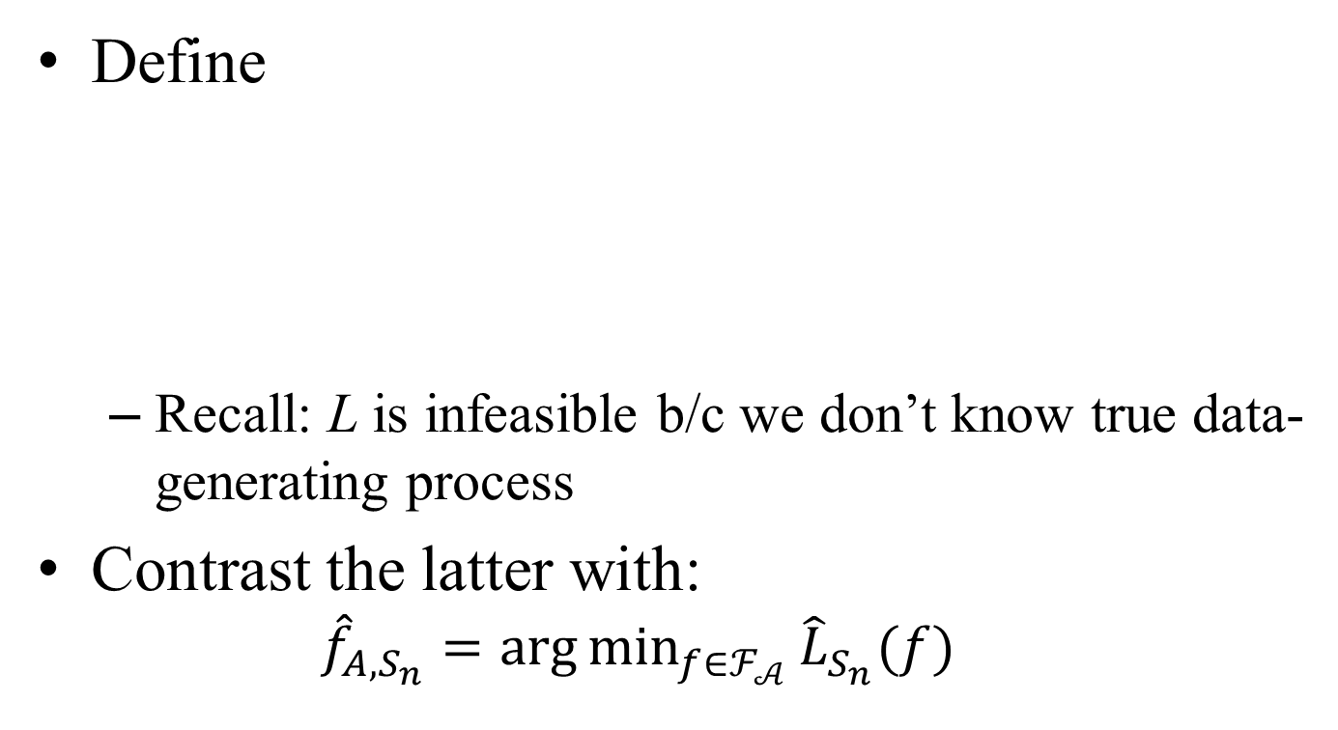
Some Notation
Define
Recall: L is infeasible b/c we don’t know true data-generating process
Contrast the latter with:
$${\hat{f}}_{A,S_{n}}=\arg{\min_{f∈ℱ_{𝒜}}{{\hat{L}}_{S_{n}}(f)}}$$
The best we can do
The best in the subset of functions
that the algorithm looks at
What the in-sample loss minimizer actually
produces given a sample

Slide 44
Performance of Algorithm
Performance of a predictor
Performance of an Algorithm
Algorithm’s expected loss
(Suppress S_{n} in some of the notation for estimator)

Slide 45
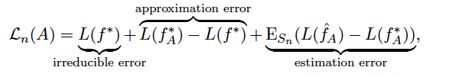
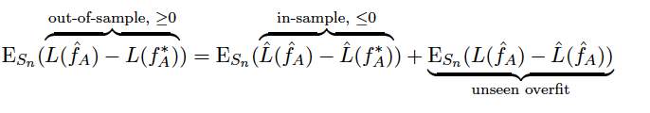
The performance of A
Understanding estimation error:
“Wrong” function
looks good in-sample
Algorithm does
not see this

Slide 46
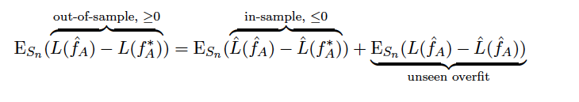
Basic Tradeoff
These two terms go hand in hand:

Slide 47
Approximation – Overfit Tradeoff
If we reduce set of f to reduce possible over-fit:
Then we fit fewer “true functions” and drive up
Only way to avoid this is if we knew information about f* so we could shrink the set

Slide 48
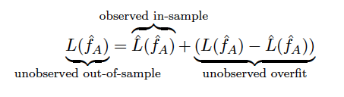
Unobserved overfit
So the problem of prediction really is managing unobserved overfit
We do well in-sample. But some of that “fit” is overfit.

Slide 49
Return to the original example
We drove down overfit by doing a constrained optimization
Greater Chance
To Overfit
Less Chance
To Overfit

Slide 50
Basic Tradeoff at the Heart of Machine Learning
Bigger function classes…
The more likely we are to get to the truth (less approximation)
The more likely we are to overfit
So we want to not just minimize in-sample error given a class of functions
We also want to decide on the class of functions
More expressive means less approximation error
More expressive means more overfit

Slide 51
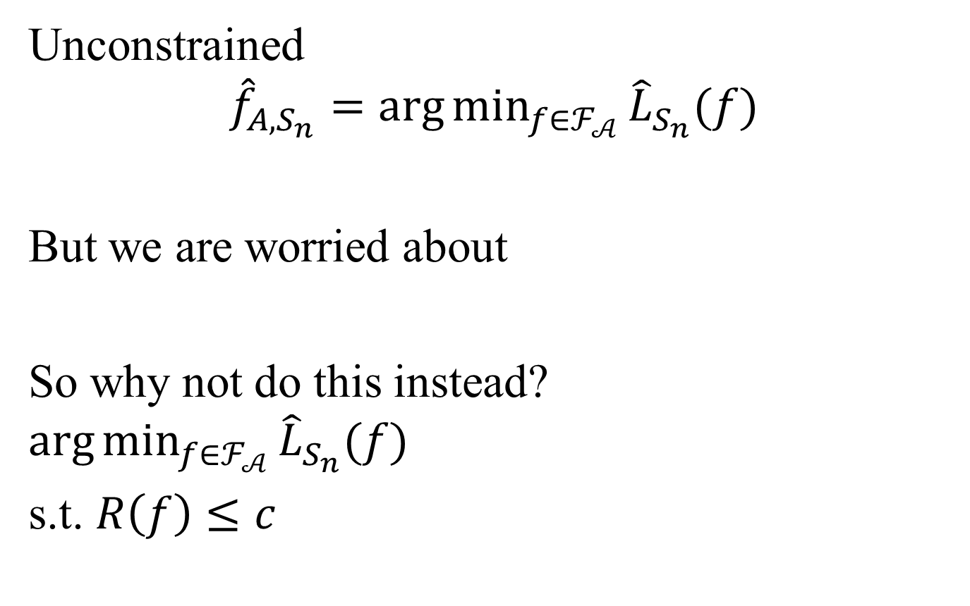
Let’s do the same thing here
Unconstrained
$${\hat{f}}_{A,S_{n}}=\arg{\min_{f∈ℱ_{𝒜}}{{\hat{L}}_{S_{n}}(f)}}$$
But we are worried about
So why not do this instead?
$$\arg{\min_{f∈ℱ_{𝒜}}{{\hat{L}}_{S_{n}}(f)}}$$
s.t. $R\left(f\right)≤c$
Complexity measure: tendency to overfit

Slide 52
Return to the original example
Reduce overfit by approximating worse
Choose less expressive function class
Greater Overfit
Less Overfit
Better approximation
Worse approximation
More Expressive
R(f) higher
Less Expressive
R(f) lower

Slide 53
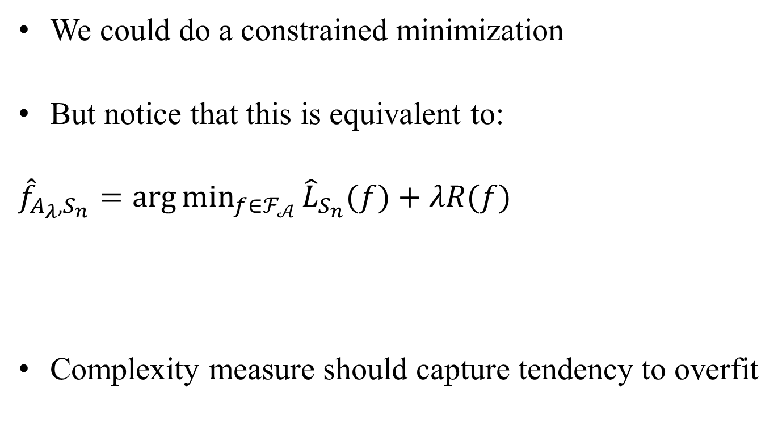
Constrained minimization
We could do a constrained minimization
But notice that this is equivalent to:
$${\hat{f}}_{A_{λ},S_{n}}=\arg{\min_{f∈ℱ_{𝒜}}{{\hat{L}}_{S_{n}}(f)}}+λR(f)$$
Complexity measure should capture tendency to overfit

Slide 54
Basic insight
Data has signal and noise
More expressive function classes-
Allow us to pick up more of the signal
But also pick up more of the noise
So the problem of prediction becomes the problem of choosing expressiveness

Slide 55
Overall Structure
Create a regularizer that:
Measures expressiveness
Penalize algorithm for choosing more expressive functions
Tuning parameter lambda
Let it weigh this penalty against in-sample fit

Slide 56

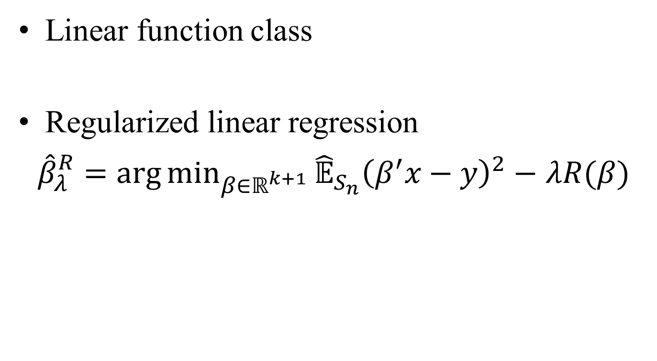
Linear Example
Linear function class
Regularized linear regression
${\hat{β}}_{λ}^{R}={\arg{\text{min}}}_{β∈ℝ^{k+1}}{\hat{𝔼}}_{S_{n}}{\left(β^{′}x−y\right)}^{2}−$ $λR(β)$

Slide 57
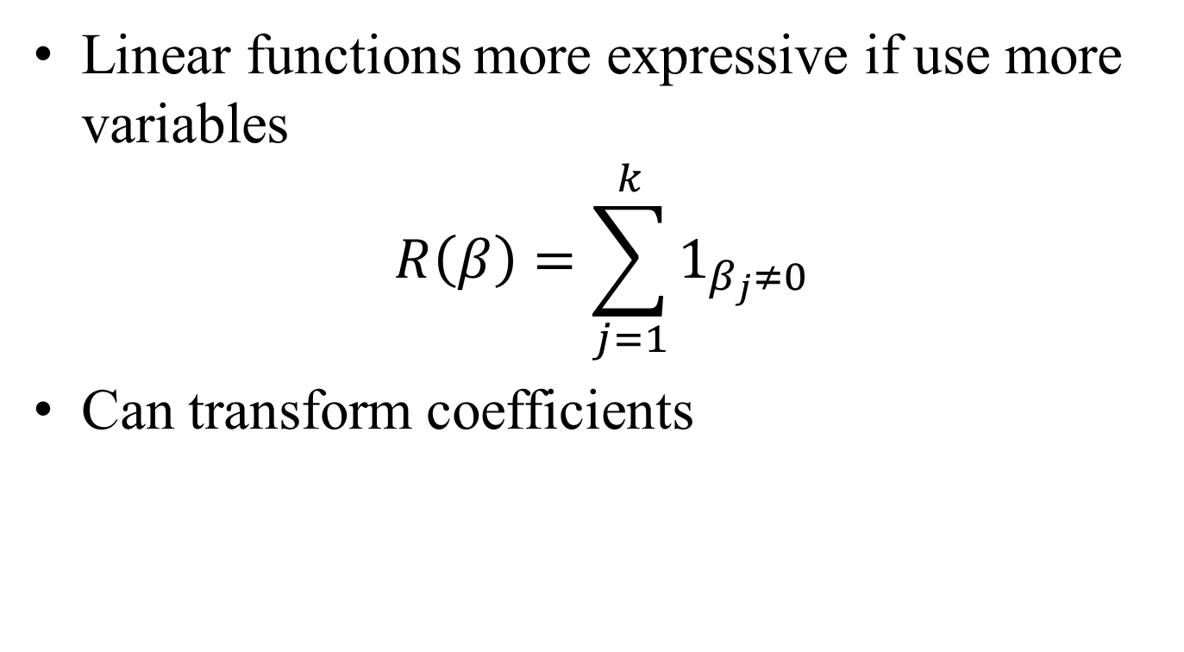
Regularizers for Linear Functions
Linear functions more expressive if use more variables
$$R\left(β\right)=\sum_{j=1}^{k}{1_{β_{j}≠0}}$$
Can transform coefficients

Slide 58
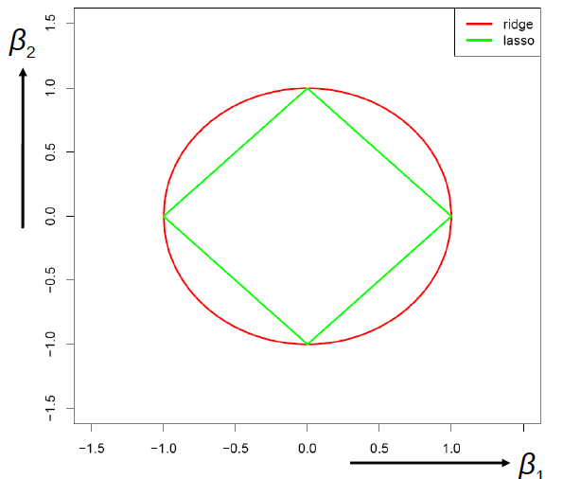


Computationally More Tractable
Lasso
Ridge

Slide 59
What makes a good regularizer?
You might think…
Bayesian assumptions
Example: Ridge
A good regularizer can build in beliefs
Those are great and useful when available
But central force is tendency to overfit
Example:
Even if true world were not sparse or priors were not normal you’d still do this

Slide 60
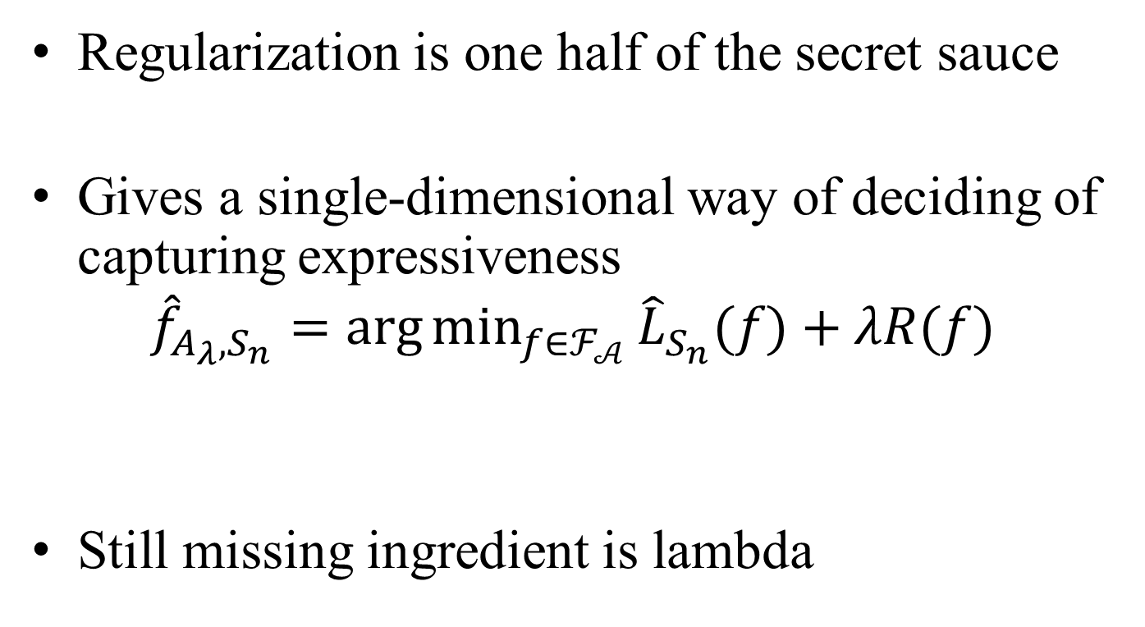
Summary
Regularization is one half of the secret sauce
Gives a single-dimensional way of deciding of capturing expressiveness
$${\hat{f}}_{A_{λ},S_{n}}=\arg{\min_{f∈ℱ_{𝒜}}{{\hat{L}}_{S_{n}}(f)}}+λR(f)$$
Still missing ingredient is lambda

Slide 61
Choosing lambda
How much should we penalize expressiveness?
How do you make the over-fit approximation tradeoff?
The tuning problem.
Use cross-validation

Slide 62
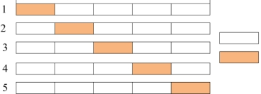
How Does Cross Validation Work?
CV-Tuning
CV-Training
Train
Tune
Tuning Set = 1/5 of Training Set

Slide 63
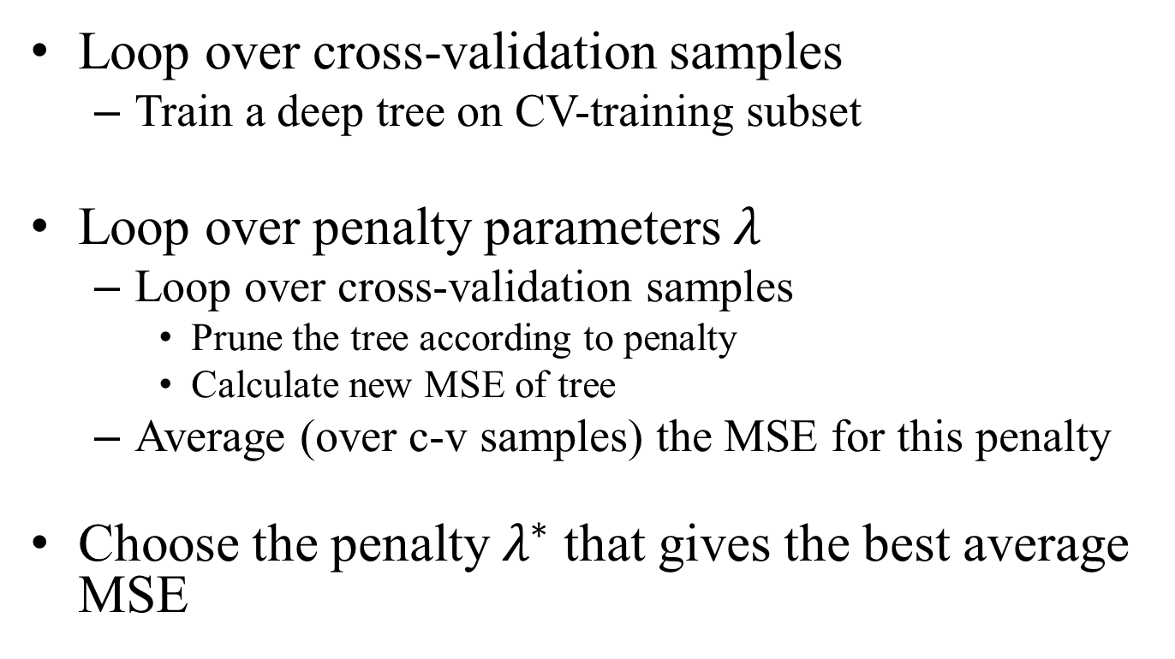
Cross-Validation Mechanics
Loop over cross-validation samples
Train a deep tree on CV-training subset
Loop over penalty parameters $λ$
Loop over cross-validation samples
Prune the tree according to penalty
Calculate new MSE of tree
Average (over c-v samples) the MSE for this penalty
Choose the penalty $λ^{∗}$ that gives the best average MSE

Slide 64
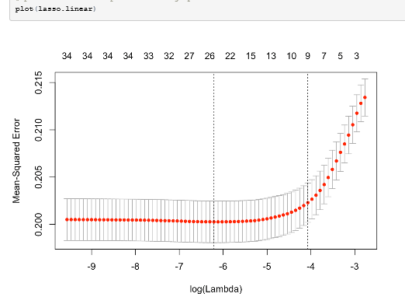
LASSO c-v Example

Slide 65
Creating Out-of-Sample In Sample
Major point:
Not many assumptions
Don’t need to know true model.
Don’t need to know much about algorithm
Minor but important point
To get asymptotics right we need to make some regularity assumptions
Side point (to which we return)
We’d like to choose best algorithm for sample size n
But this will not do that. Why?

Slide 66
Why does this work?
Not just because we can split a sample and call it out of sample
It’s because the thing we are optimizing is observable (easily estimable)

Slide 67
This is more than a trick
It illustrates what separates prediction from estimation:
I can’t ‘observe’ my prior.
Whether the world is truly drawn from a linear model
But prediction quality is observable
Put simply:
Validity of predictions are measurable
Validity of coefficient estimators require structural knowledge
This is the essential ingredient to prediction: Prediction quality is an empirical quantity not a theoretical guarantee

Slide 68
Why does this work?
1. It’s because the thing we are optimizing is
observable
2. By focusing on prediction quality we have reduced dimensionality

Slide 69
To understand this…
Suppose you tried to use this to choose coefficients
Ask which set of coefficients worked well out-of sample.
Does this work?
Problem 1: Estimation quality is unobservable
Need the same assumptions as algorithm to know whether you “work” out of sample
If you just go by fit you are ceding to say you want best predicting model
Problem 2: No dimensionality reduction.
You’ve got as many coefficients as before to search over

Slide 70
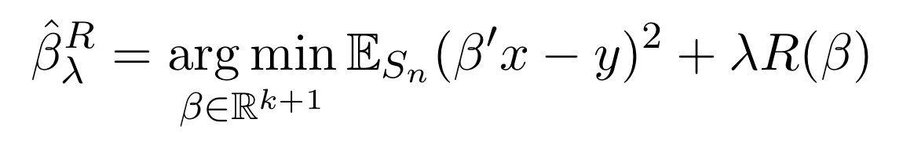
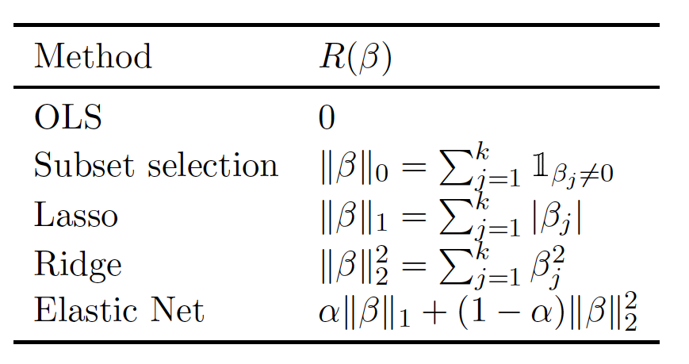

Slide 71
Bayesian Interpretation of Ridge

Slide 72
Bayesian Interpretation of Ridge

Slide 73
Bayesian Interpretation of Ridge

Slide 74
POST-Lasso
Important distinction:
Use LASSO to choose variables
Use OLS on these variables
How should we think about these?

Slide 75
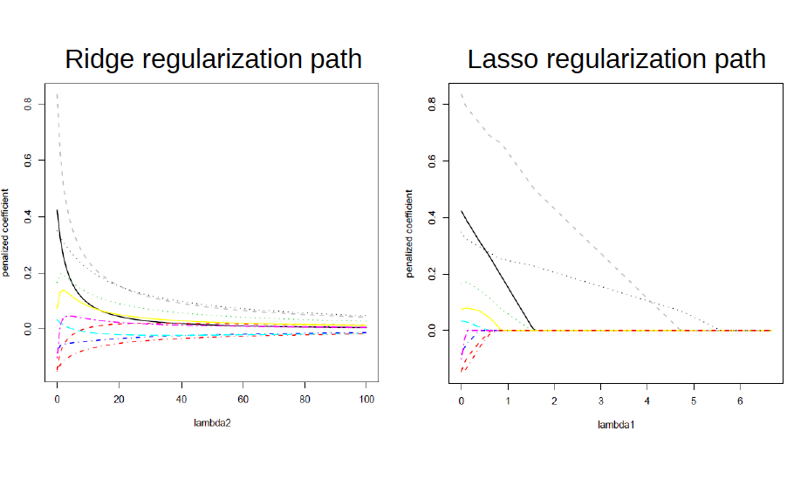

Slide 76
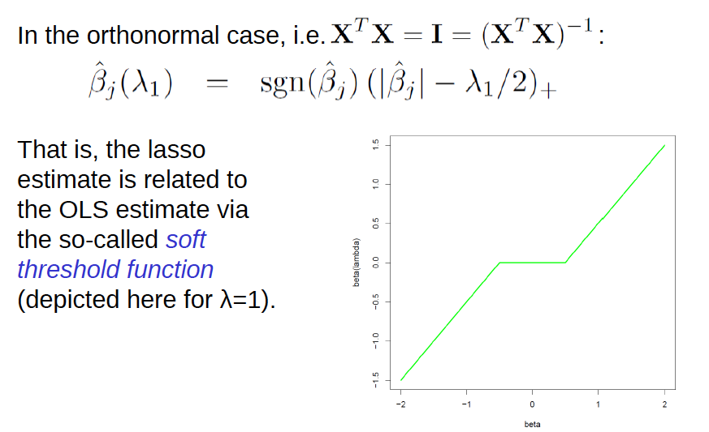

Slide 77
Why not?
Why not Hard Thresholding?
Soft Thresholding

Slide 79
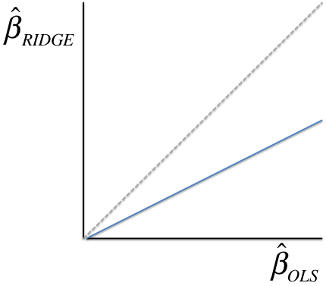
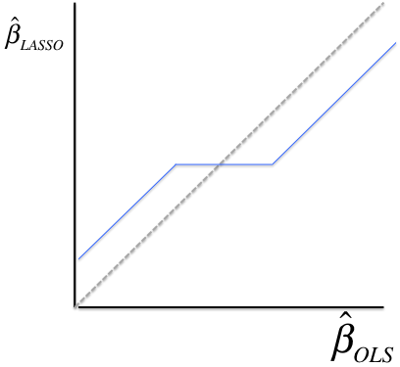
Can be very misleading

Slide 80
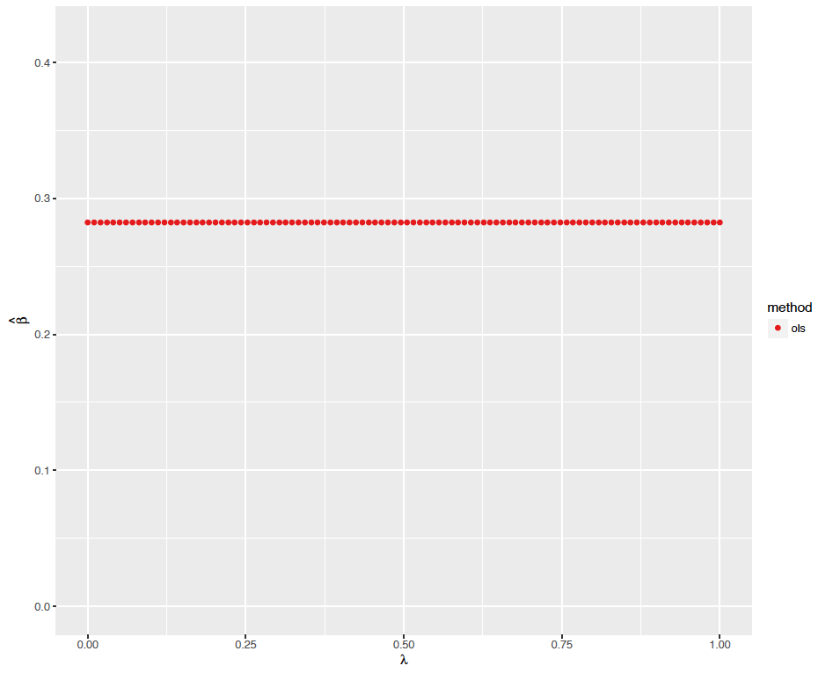
Coefficient on Number of Bedrooms

Slide 81
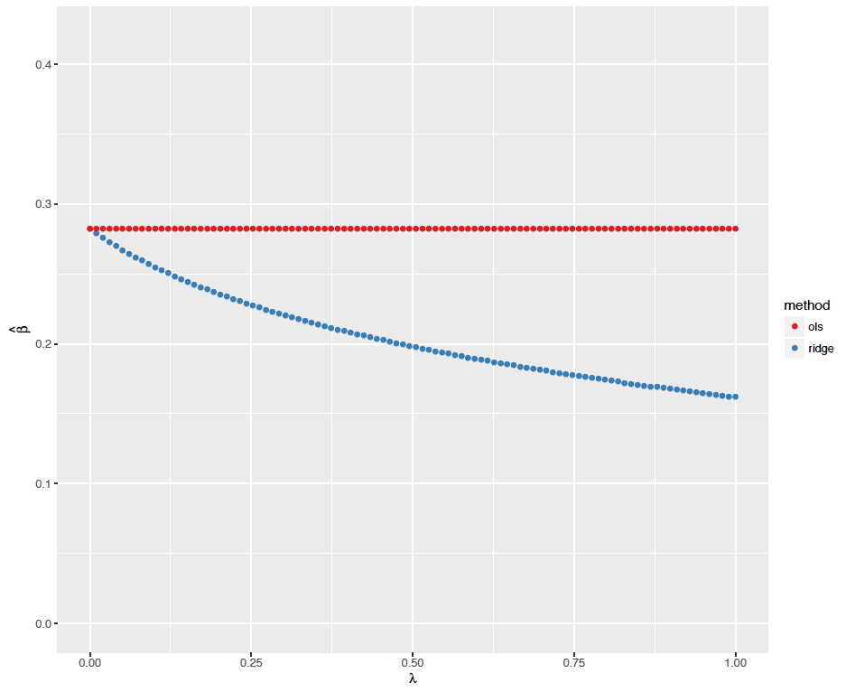
Coefficient on Number of Bedrooms

Slide 82
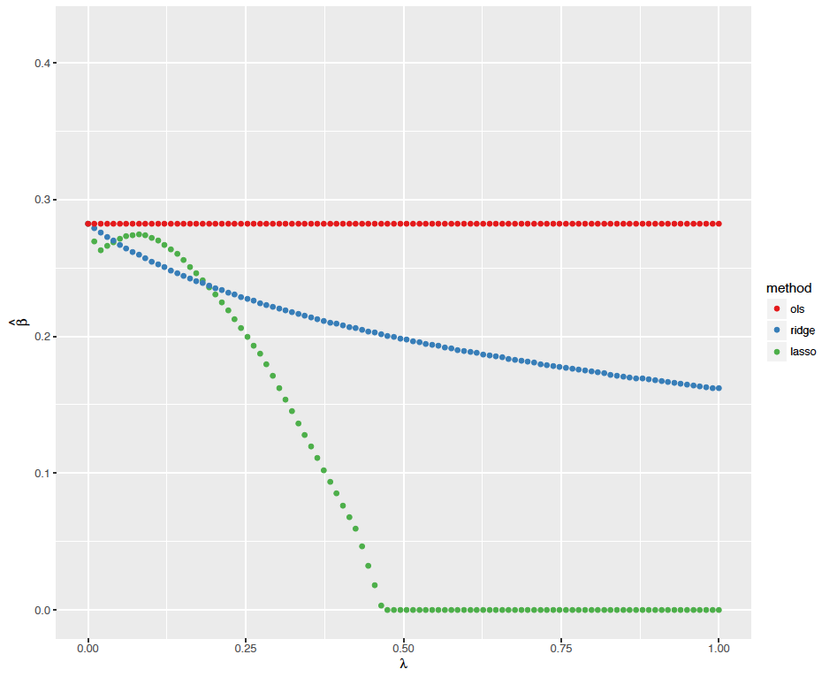
Coefficient on Number of Bedrooms
What is this about?

Slide 83
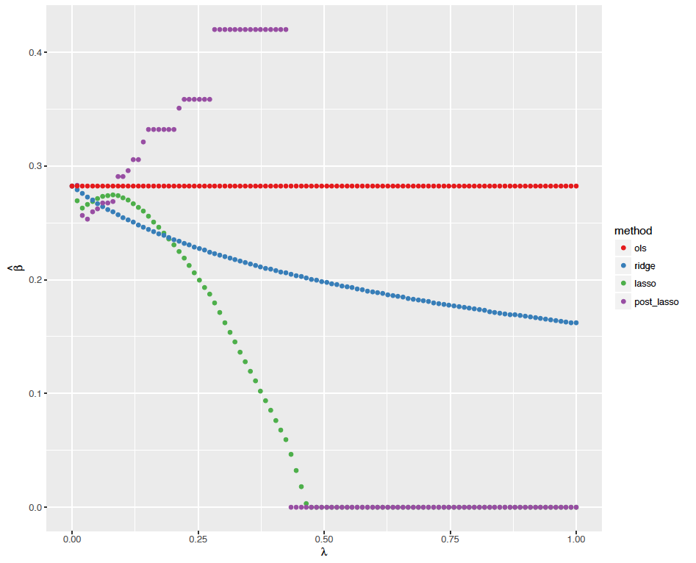
Coefficient on Number of Bedrooms
What is this about?

Slide 84
